Slide 1

Docker
14-05-2024
Notes:
https://www.freepik.com/

Slide 2
Table Of Contents
Docker Overview
01
Docker Use Case
02
Docker Pros & Cons
03
Conclusion
04

Slide 3
Docker Overview
Notes:
https://www.freepik.com/

Slide 4

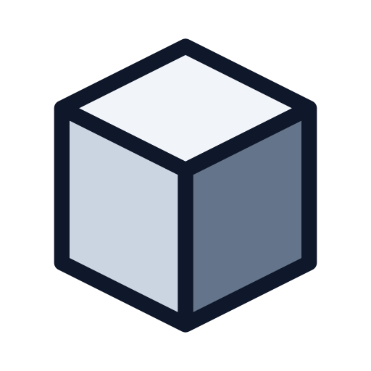

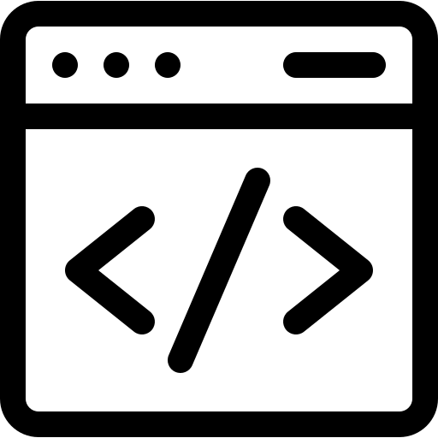
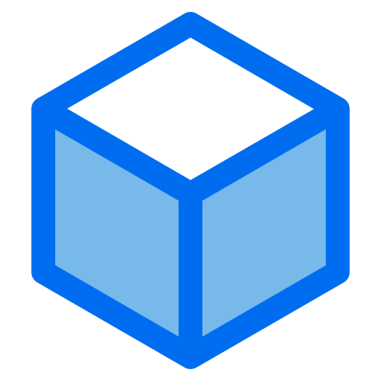

Docker Architecture
Client
Daemon
Registry
Hub
OR
Remote API
Containers
Images

Slide 5
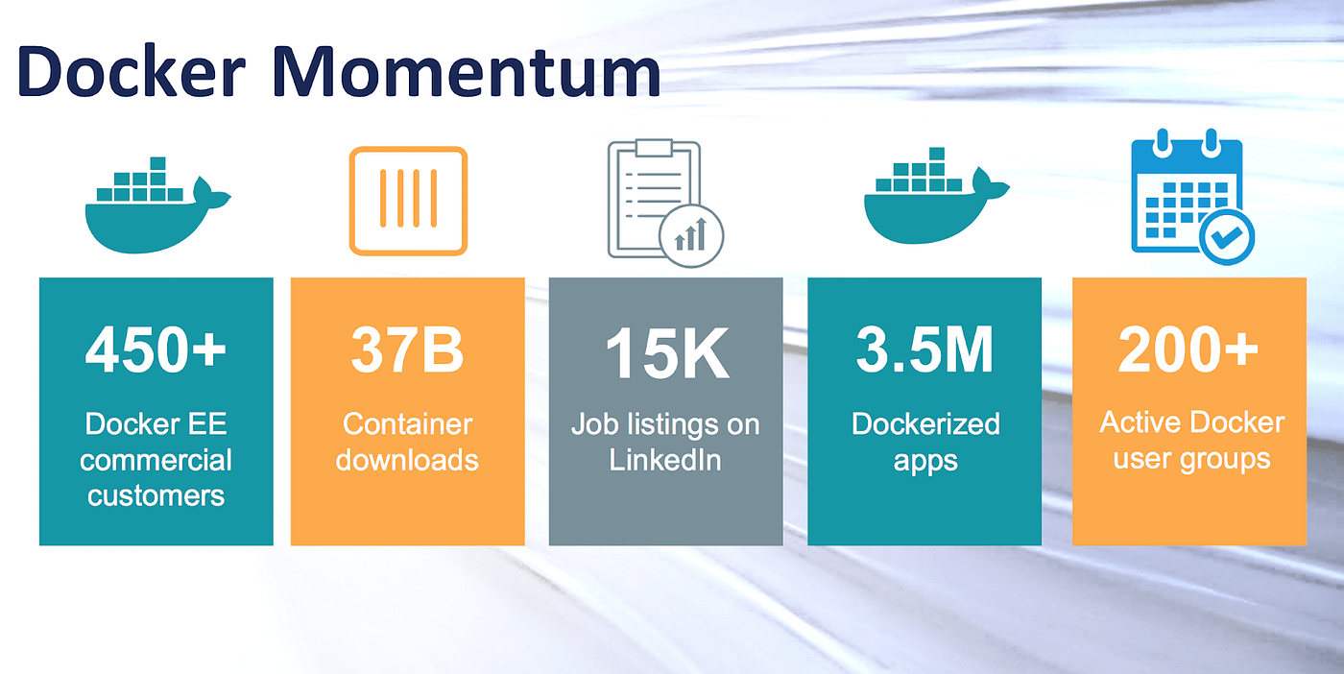

Slide 6

Docker
Use Case
Notes:
https://get.pxhere.com/photo/job-office-collaboration-design-interior-design-white-collar-worker-conversation-learning-employment-hand-desk-furniture-interview-building-team-gesture-management-1535603.jpg
https://pixnio.com/free-images/2017/08/29/2017-08-29-16-04-13-1000x667.jpg
https://pixnio.com/free-images/2020/09/01/2020-09-01-09-33-31-1200x800.jpg
https://live.staticflickr.com/65535/50938102118_144ee02523_b.jpg

Slide 7




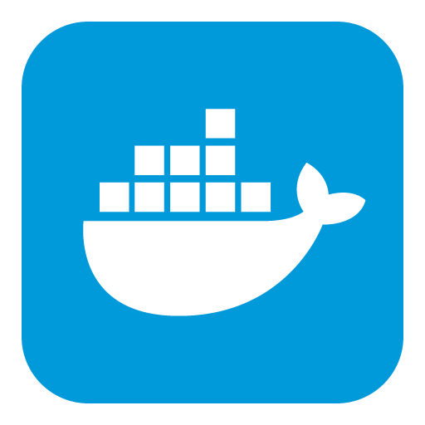




Use Case
Spotify
Amazon
Technology
E-Commerce
Netflix
eBay
Docker
JPMorgan Chase
Philips
Finance
Healthcare
Goldman Sachs
J&J

Slide 8




Docker
PROS & CONS
Notes:
https://unsplash.com/photos/5QgIuuBxKwM
<a href='https://www.freepik.com/photos/asian-guy'>Asian guy photo created by benzoix - www.freepik.com</a>

Slide 9




Pros
Portability
Scalability
Efficiency
Isolation
Faster Deployment
Complexity
Persistent Data Storage
Learning Curve
Overhead
Cons

Slide 10

Conclusion
Docker revolutionizes application development and deployment by providing a consistent, portable, and efficient environment for running applications.
Its benefits in terms of scalability, portability, and isolation make it a powerful tool for modern software development practices.
However, the complexities of orchestration and security need careful management.

Slide 11
THANK
YOU.
Notes:
https://www.freepik.com/

